Slide 1
Car Price PredictionProject

Slide 2
Problem Statement
Sudden out break of covid-19 has hit hard many businesses including used car sales market. Due to this pandemic, there are many changes in the used car prices so the old machine learning models used by companies are no longer valid for post pandemic data. So here we are working on this project in 2 phases:
Data Collection: I collected used car data from two sites, cardekho.com and cars24.com.
Analysing the data and building the model.

Slide 3
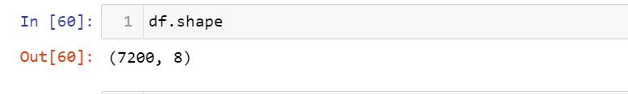
Exploratory Data Analysis
Shape of the data:
Data set is collected from cars24 and carDekho from various cities as Delhi, NCR, Mumbai, Hyderabad, Chennai, Banglore,Kolkata,Pune etc. Below is the shape of data:
.
Null values present:
The dataset has no null values.

Slide 4
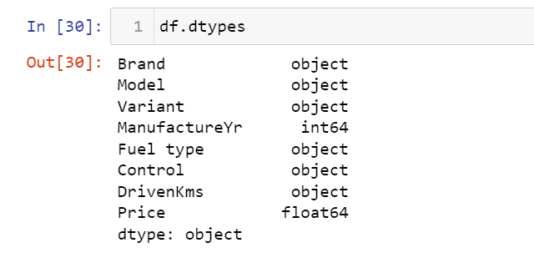
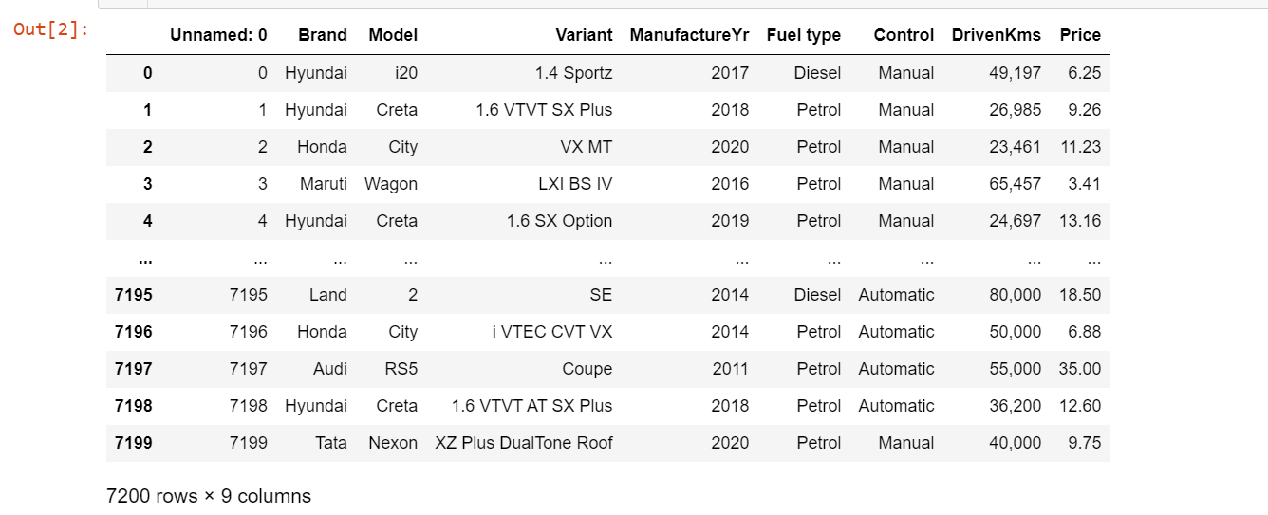
Following are the columns present and their respective data types:
Here is the glimpse of data:

Slide 5
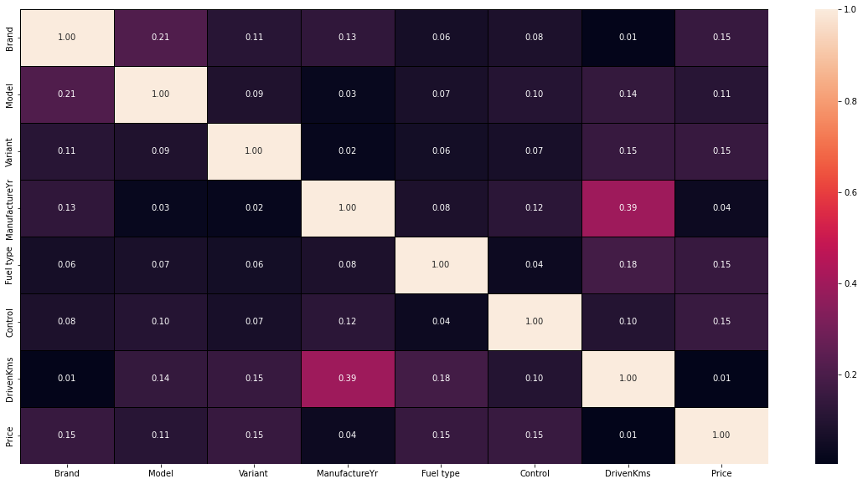
The dataset had no null values but the label price was as object data type so I converted it into float type.
While analysing the data I came across that the prices of high-end cars like Mercedes and BMW were in crores but filled as lakhs so I converted such kind of prices to lakhs.
DrivenKms feature was also object type so I converted it into float type as well.
Few features such as Brand, Model, Variant, ManufactureYr, Fuel type and Contol are categorical in nature so applied ordinal encoding on them.
As per heatmap multicollinearity doesnot exists but in order to be sure I calculated vif score and found out
that the manufactureYr is greater than 10 but since its an important feature so could not drop it.

Slide 6
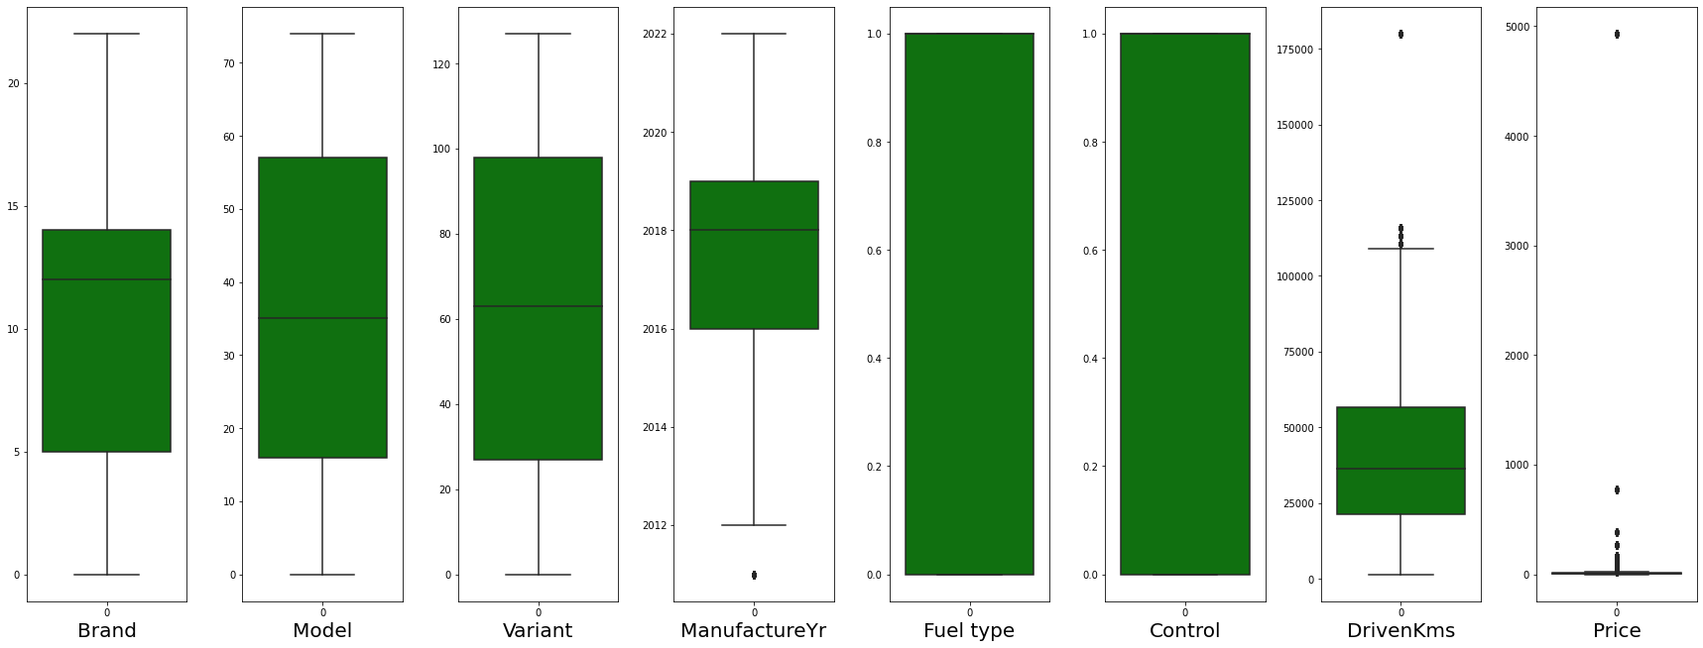
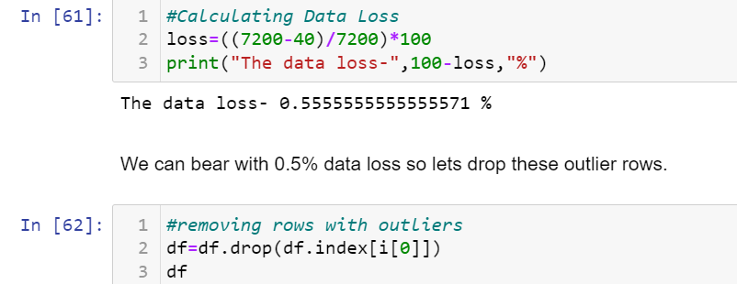
Outliers are present in DrivenKms and Price but since Price is a label so we would consider outlier in only
DrivenKms. So treated it using z-score technique.
Since the data loss was only 0.5% so we dropped rows having outliers.

Slide 7
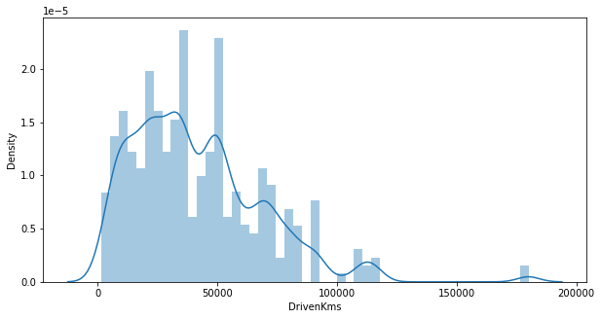
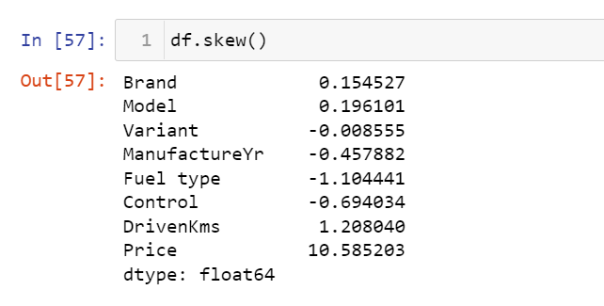
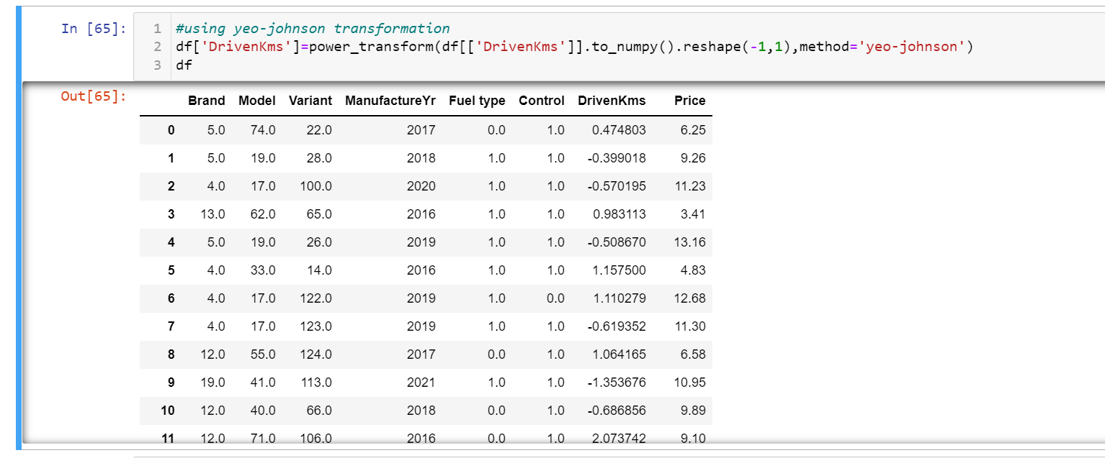
We could observe skewness in DrivenKms. Considering the range of skewness as -0.5 to 0.5, we could observe that
DrivenKms skewness value is 1.2 which is not in range (-0.5, 0.5) so we treated it using power transform method.
We fixed this by using yeo-Johnson transformation technique.

Slide 8
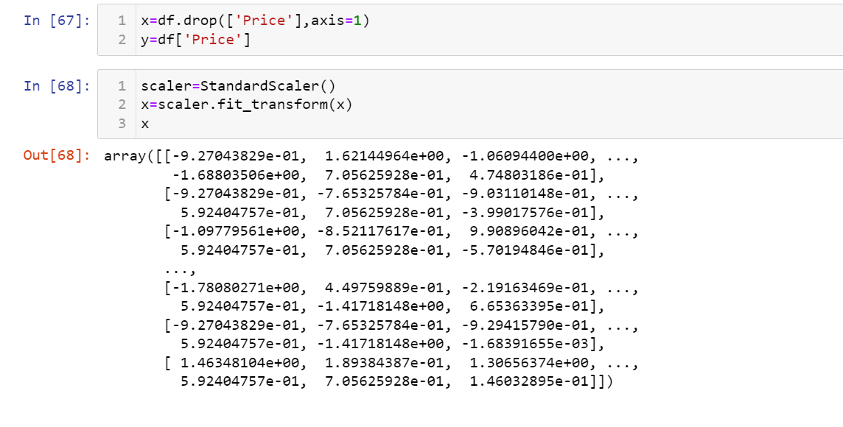
Data was then normally distributed using standardisation technique.

Slide 9
Analysing relationship between features

Slide 10
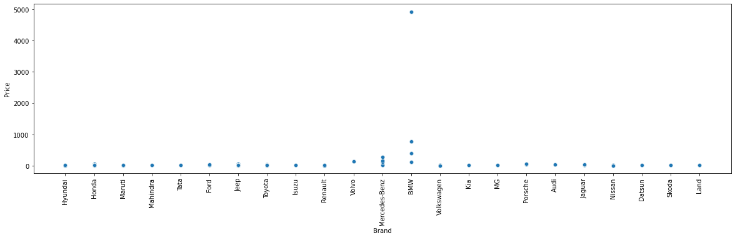
Here we can see that how price varies with the car brand. BMW used cars are most expensive.
The price is in lakhs.

Slide 11
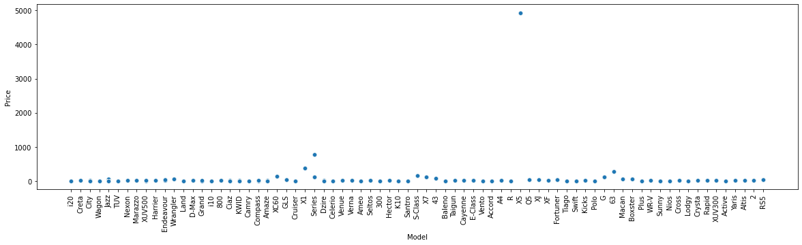
We can observe that x1, series and 63 model of BMW and Mercedes are the costliest even if the cars are used.

Slide 12
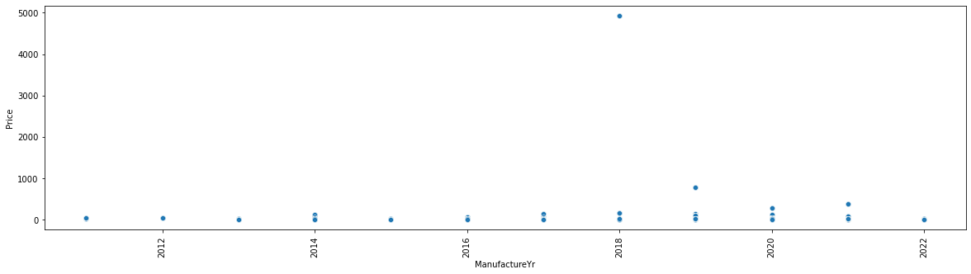
We can observe that newer the used car higher is the price.

Slide 13
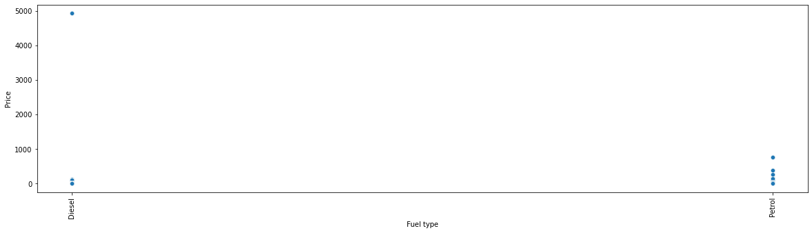
Petrol cars are more expensive than diesel cars.

Slide 14
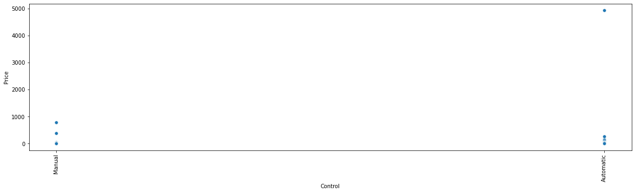
Automatic cars are costlier than manual.

Slide 15
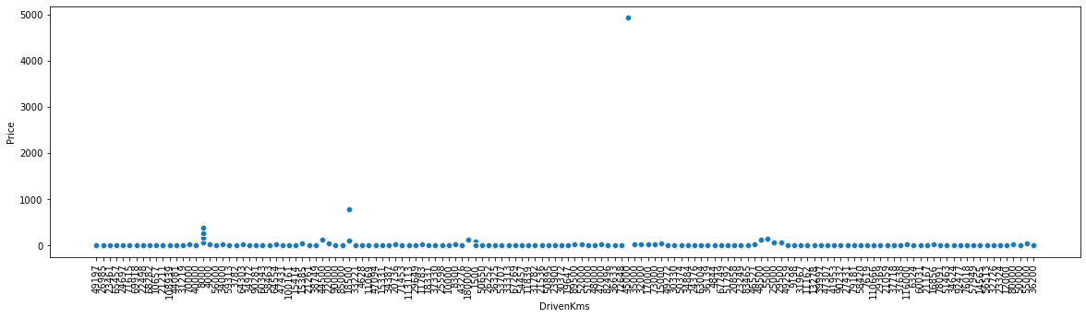
Lesser the driven kilometers higher is the cost. That means lesser the driven kilometers better the state of car
so higher the price.

Slide 16
Hardware and Software Requirements and Tools Used
We imported following packages:
import pandas as pd
import numpy as np
import matplotlib.pyplot as plt
import seaborn as sns
from sklearn.preprocessing import OrdinalEncoder
from sklearn.preprocessing import LabelEncoder
from statsmodels.stats.outliers_influence import variance_inflation_factor
from scipy.stats import zscore
from sklearn.model_selection import GridSearchCV
from sklearn.preprocessing import StandardScaler
from sklearn.preprocessing import power_transform
from sklearn.model_selection import train_test_split
from sklearn.model_selection import cross_val_score
from sklearn import metrics
from sklearn.metrics import mean_squared_error, mean_absolute_error
We also installed XGBoost Regressor.

Slide 17
Run and Evaluate selected models

Slide 18
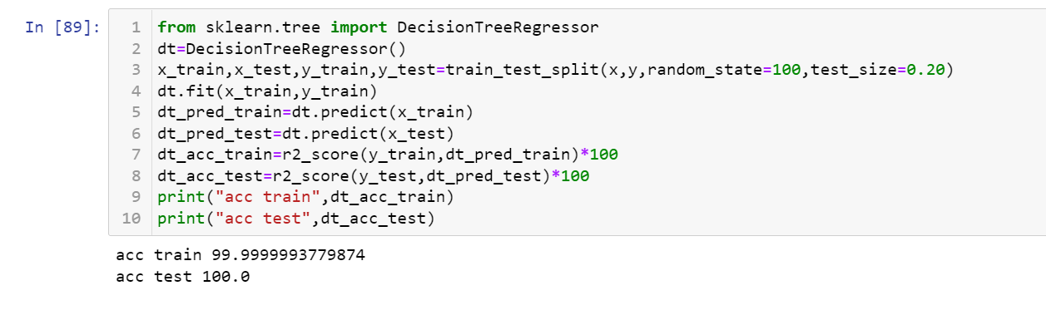
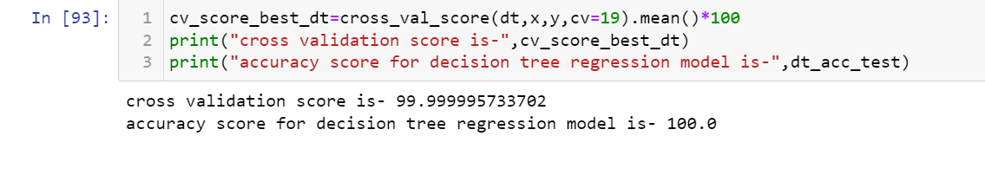
Decision Tree Regression
We applied this algorithm and found the train accuracy to be 100% and test accuracy to be 99.9%.
The test accuracy for decision tree regression is 100% and its cv score is 99.9% thus making us sure that
the model is not overfitted, although decision tree regressor is prone to overfitting.

Slide 19
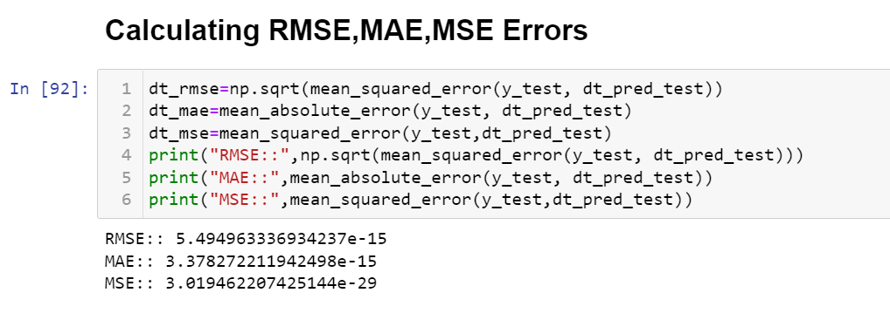
We also tested this model on other metrics:
We calculated Root mean square error, Mean absolute error and Mean square errors and there values are shown
in the snapshot below:
Looking at these errors we can say that model is performing really well.

Slide 20
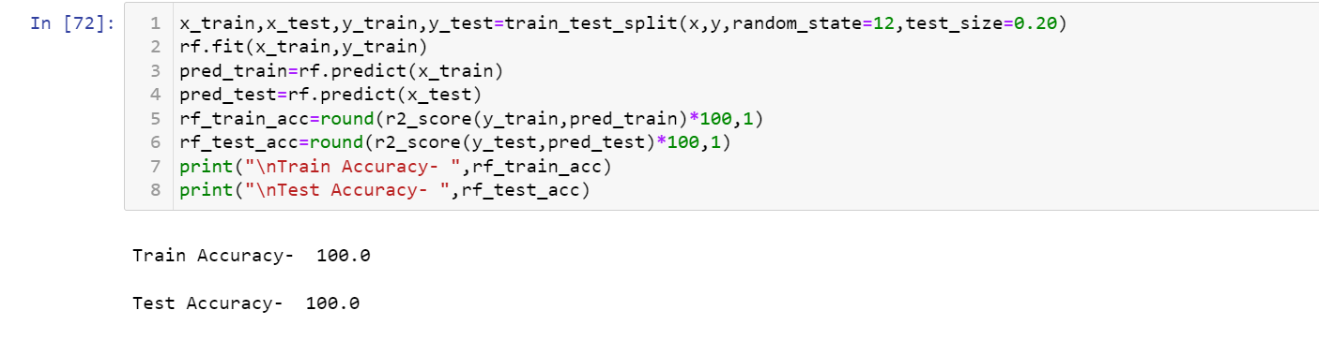
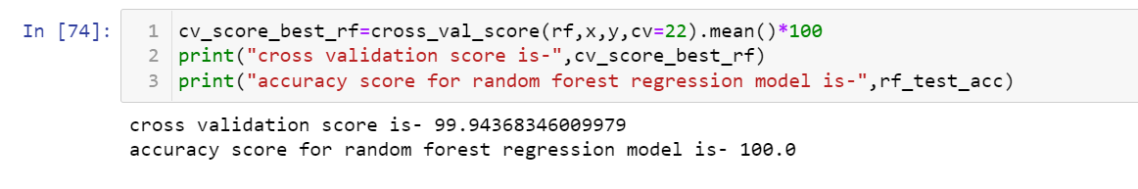
Random Forest Regressor
We applied this algorithm and found the train accuracy to be 100% and test accuracy to be 100%.
The test accuracy for random forest regression is 100% and its cv score is 99.9% thus making us sure that
the model is not overfitted.

Slide 21
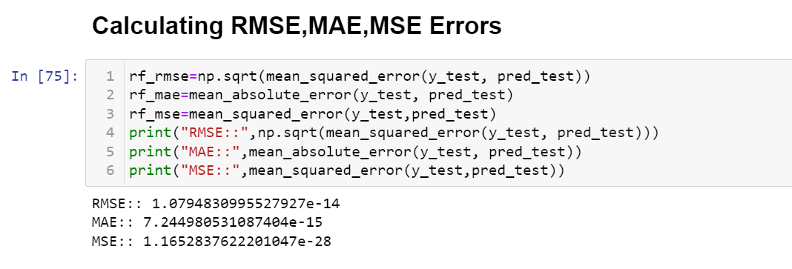
We also tested this model on other metrics:
We calculated Root mean square error, Mean absolute error and Mean square errors and there values are
shown in the snapshot below:
Looking at these errors we can say that model is performing really well.

Slide 22
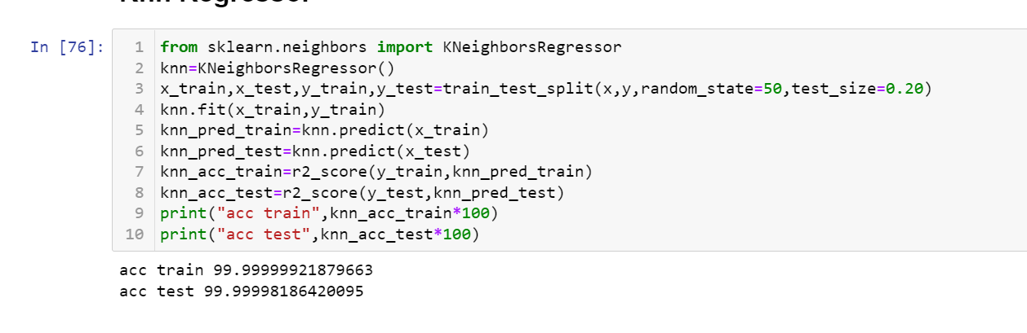
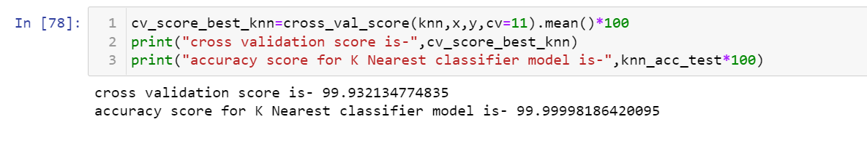
Knn Regressor
We applied this algorithm and found the train accuracy to be 99.9% and test accuracy to be 99.9%.
The test accuracy for Knn regression is 99.9% and its cv score is 99.9% thus making us sure that the model
is not overfitted.
We also tested this model on other metrics:

Slide 23
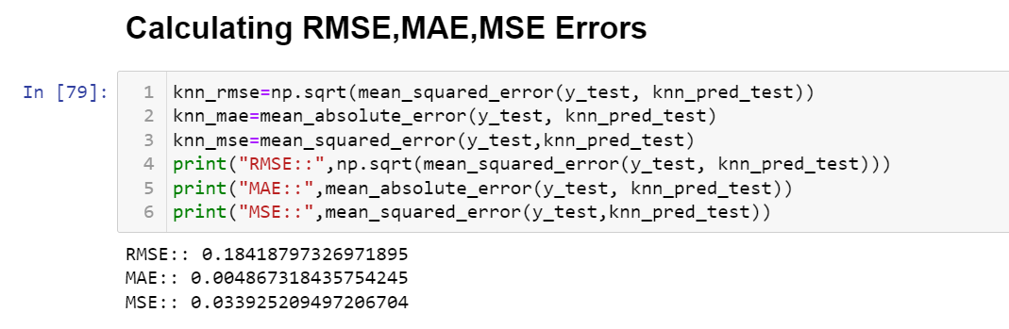
We also tested this model on other metrics:
We calculated Root mean square error, Mean absolute error and Mean square errors and there values are
shown in the snapshot below:
Looking at these errors we can say that model is performing well but not as good as previous two models.

Slide 24
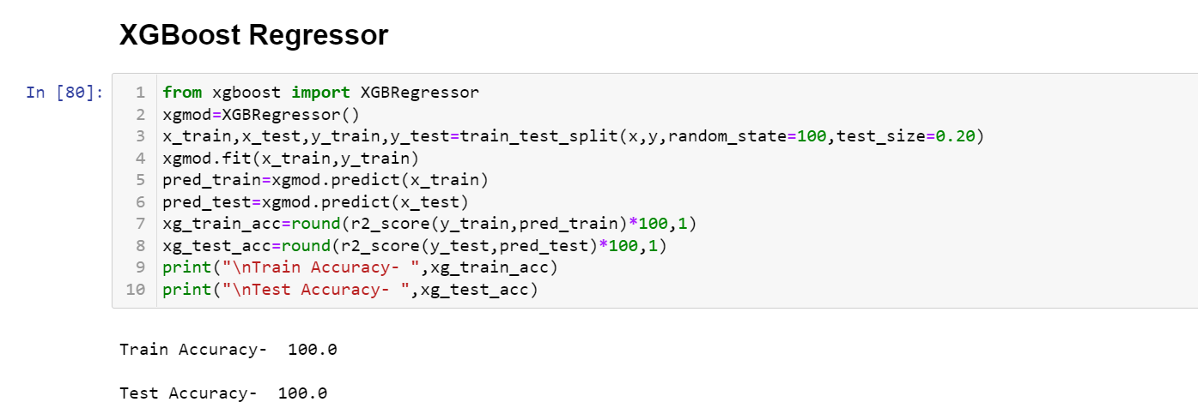
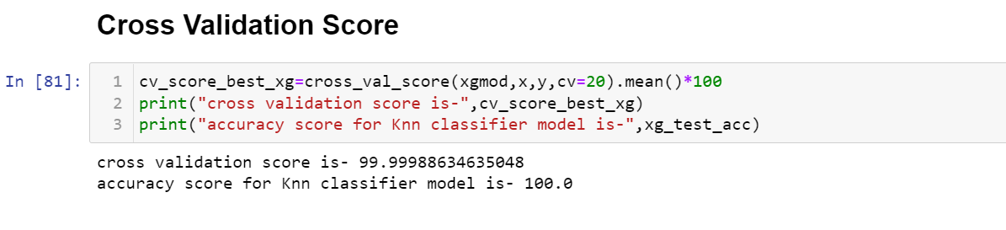
XGBoost Regressor
We applied this algorithm and found the train accuracy to be 100% and test accuracy to be 100%.
The test accuracy for XGBoost regression is 100% and its cv score is 99.9% thus making us sure that the model is
not overfitted.

Slide 25
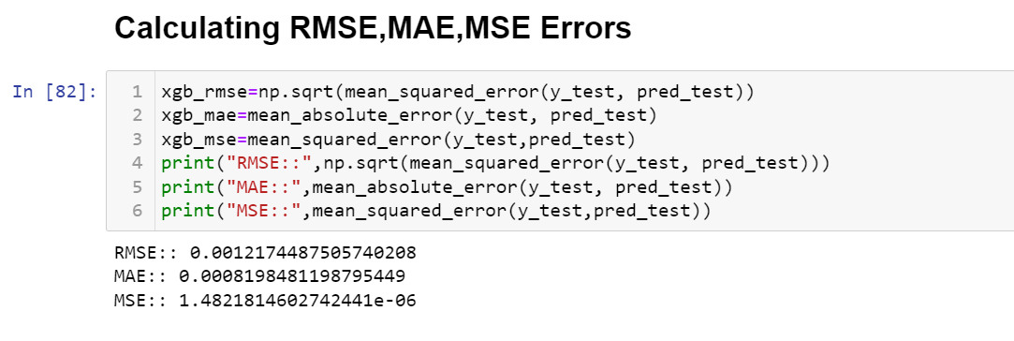
We also tested this model on other metrics:
We calculated Root mean square error, Mean absolute error and Mean square errors and there values are
shown in the snapshot below:
Looking at these errors we can say that model is performing well but not as good as decision tree regressor
and random forest regressor.

Slide 26
The best performing model is random forest Regressor as its test accuracy and CV score both are almost same. The Root mean square error, mean absolute error and mean square error is least for random forest regressor so we will finalize this model.
Since the accuracy is at its best so we don’t need to perform hyper parameter tuning on it. so lets save our model.

Slide 27
CONCLUSION

Slide 28
From the above study we can conclude that if any used car is just 3-4 years old, is of petrol type, automatic and has driven less kilometres then their cost should be comparatively higher than other normal cars.

